Slide 1

Case Study
Case study by
Amit kumar singh
Kalluri sowjanya
Ritik Agrawal
Aditya kumar shrivastava

Slide 2
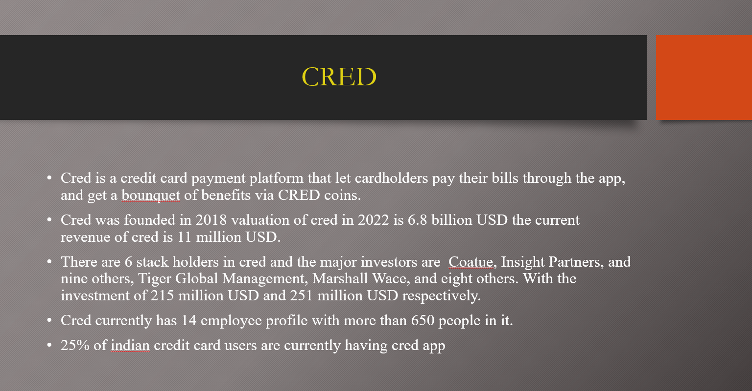
CRED
Cred is a credit card payment platform that let cardholders pay their bills through the app, and get a bounquet of benefits via CRED coins.
Cred was founded in 2018 valuation of cred in 2022 is 6.8 billion USD the current revenue of cred is 11 million USD.
There are 6 stack holders in cred and the major investors are Coatue, Insight Partners, and nine others, Tiger Global Management, Marshall Wace, and eight others. With the investment of 215 million USD and 251 million USD respectively.
Cred currently has 14 employee profile with more than 650 people in it.
25% of indian credit card users are currently having cred app

Slide 3
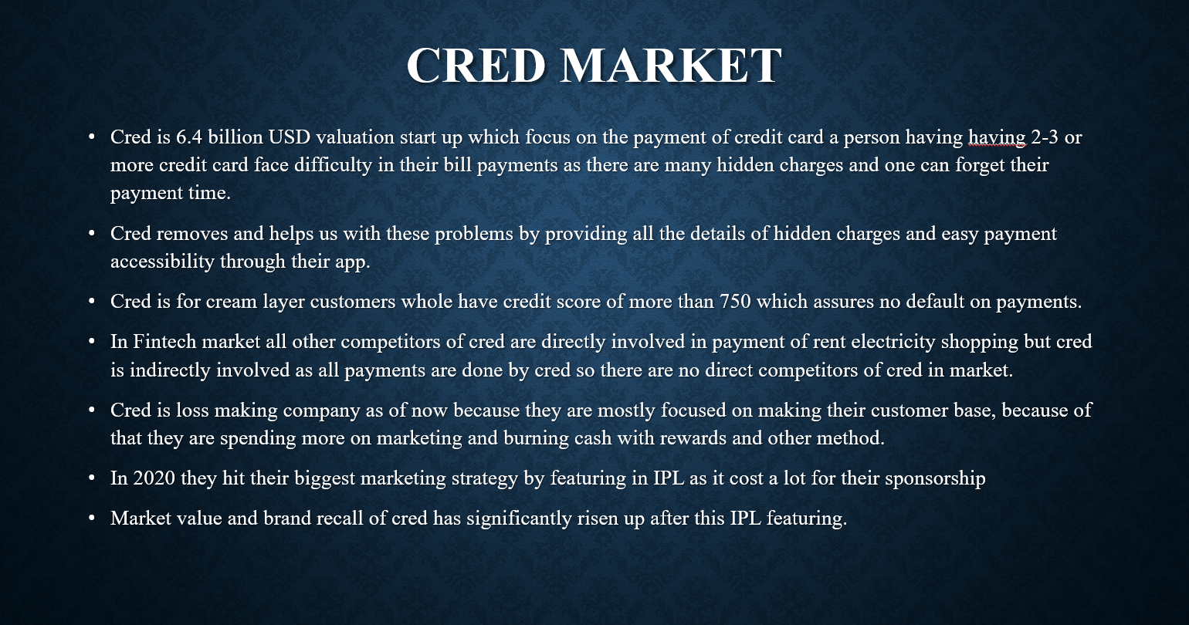
CRED MARKET
Cred is 6.4 billion USD valuation start up which focus on the payment of credit card a person having having 2-3 or more credit card face difficulty in their bill payments as there are many hidden charges and one can forget their payment time.
Cred removes and helps us with these problems by providing all the details of hidden charges and easy payment accessibility through their app.
Cred is for cream layer customers whole have credit score of more than 750 which assures no default on payments.
In Fintech market all other competitors of cred are directly involved in payment of rent electricity shopping but cred is indirectly involved as all payments are done by cred so there are no direct competitors of cred in market.
Cred is loss making company as of now because they are mostly focused on making their customer base, because of that they are spending more on marketing and burning cash with rewards and other method.
In 2020 they hit their biggest marketing strategy by featuring in IPL as it cost a lot for their sponsorship
Market value and brand recall of cred has significantly risen up after this IPL featuring.

Slide 4
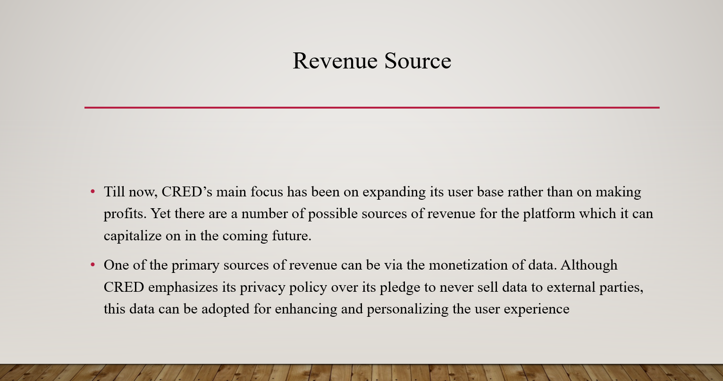
Revenue source
Till now, CRED’s main focus has been on expanding its user base rather than on making profits. Yet there are a number of possible sources of revenue for the platform which it can capitalize on in the coming future.
One of the primary sources of revenue can be via the monetization of data. Although CRED emphasizes its privacy policy over its pledge to never sell data to external parties, this data can be adopted for enhancing and personalizing the user experience

Slide 5
CUSTOMERS VISIT V/S USERS
This is a graph showing how many customers in each year visiting the cred and how many of them converting into their customers
The max conversion is in 2021 because of their marketing strategy and brand recongnition
and the lowest is in 2020 because of the Pandemic

Slide 6
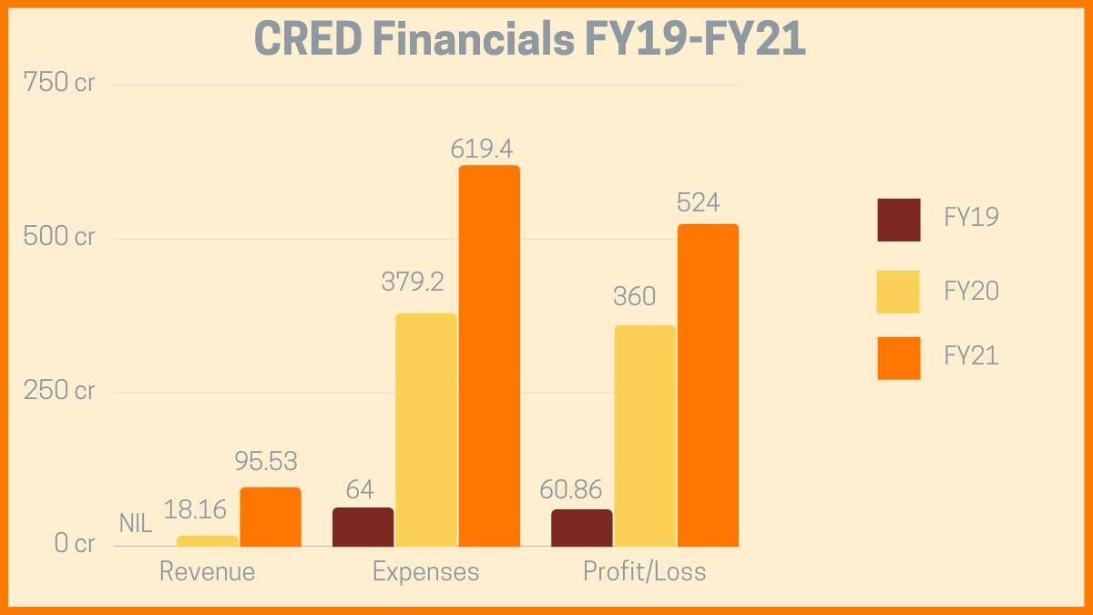
Financial Sheet

Slide 7
EXPENSES BREAKDOWN
These are the expenses done by cred in recent four financial years and the resulting from this calculation is that they have spent their mostly budget in marketing.
And second most expenditure is on employee salary.

Slide 8
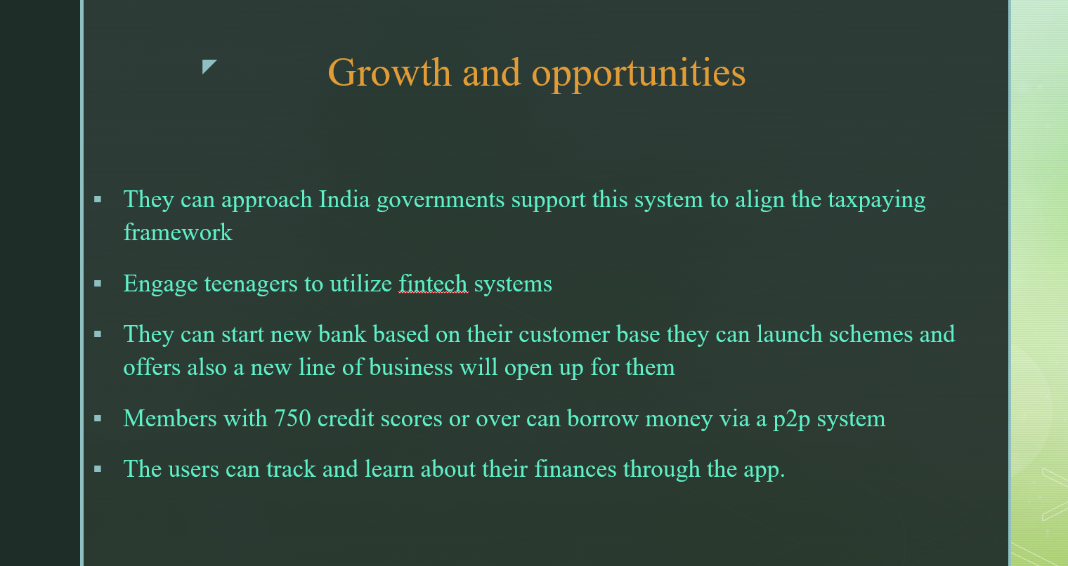
Growth and opportunities
They can approach India governments support this system to align the taxpaying framework
Engage teenagers to utilize fintech systems
They can start new bank based on their customer base they can launch schemes and offers also a new line of business will open up for them
Members with 750 credit scores or over can borrow money via a p2p system
The users can track and learn about their finances through the app.

Slide 9
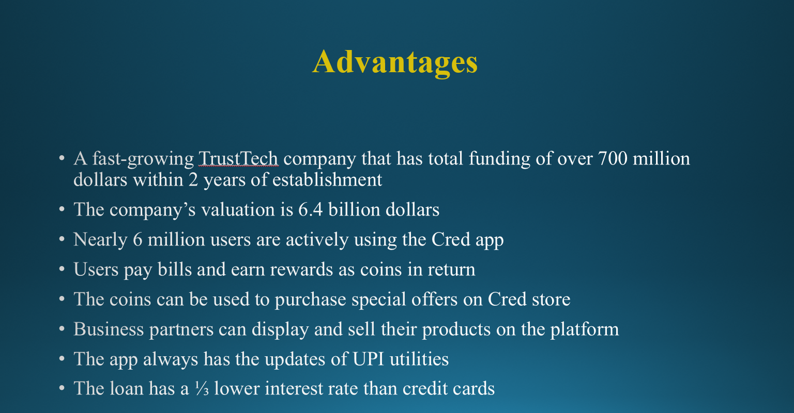
Advantages
A fast-growing TrustTech company that has total funding of over 700 million dollars within 2 years of establishment
The company’s valuation is 6.4 billion dollars
Nearly 6 million users are actively using the Cred app
Users pay bills and earn rewards as coins in return
The coins can be used to purchase special offers on Cred store
Business partners can display and sell their products on the platform
The app always has the updates of UPI utilities
The loan has a ⅓ lower interest rate than credit cards

Slide 10
Key Challenges
Data privacy and protection of customers are highly vulnerable to hacking
A credit score is quite high for low and lower-middle-class people
The Cred loan limit is relatively low as it only suits small businesses
Governments may seek private data of taxpayers from the company

Slide 11
Concerns
Lending money via a p2p feature is flexible as lenders can request a withdrawal from borrowers anytime with accumulated interests of the borrowing period
Users can only borrow a maximum of 5 million Rupees from the platform, which is quite low
Despite the company having gathered an enormous funding, it only has roughly $70,000 in an annual revenue
Putting financial data on a third-party platform is risky

Slide 12
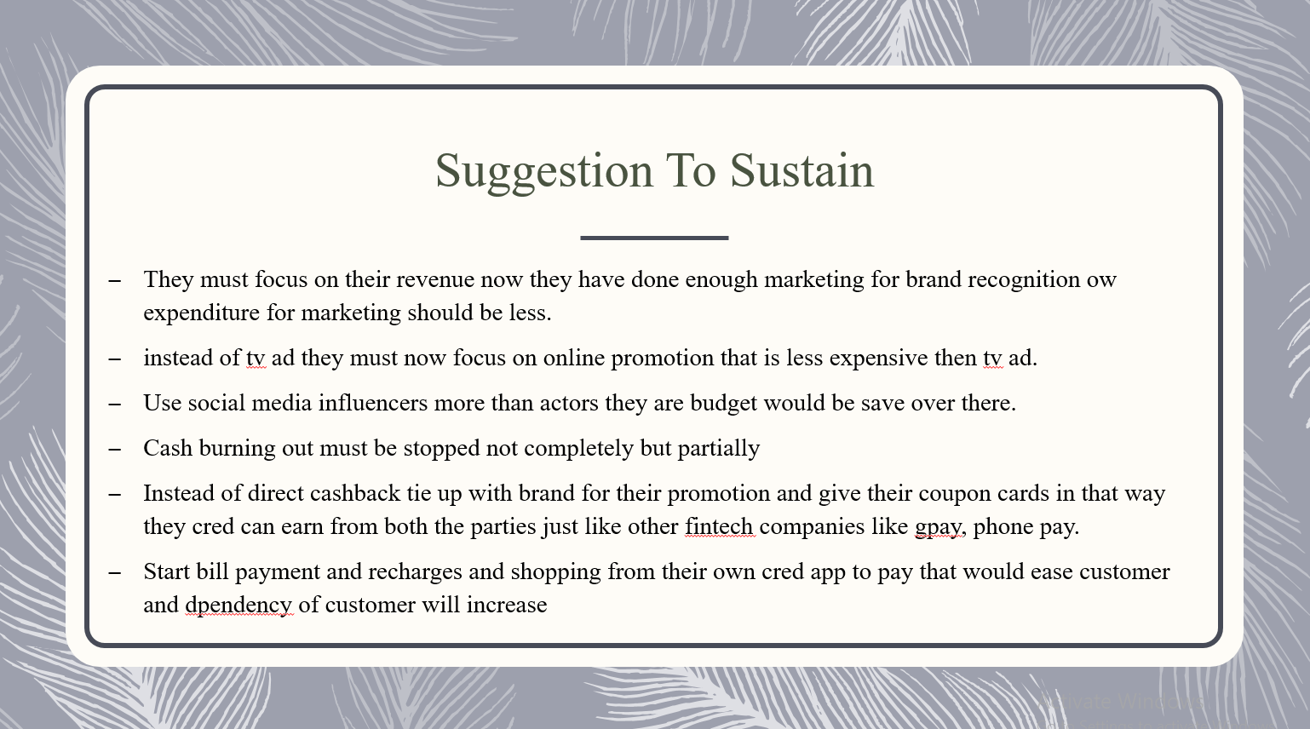
Suggestion To Sustain
They must focus on their revenue now they have done enough marketing for brand recognition ow expenditure for marketing should be less.
instead of tv ad they must now focus on online promotion that is less expensive then tv ad.
Use social media influencers more than actors they are budget would be save over there.
Cash burning out must be stopped not completely but partially
Instead of direct cashback tie up with brand for their promotion and give their coupon cards in that way they cred can earn from both the parties just like other fintech companies like gpay, phone pay.
Start bill payment and recharges and shopping from their own cred app to pay that would ease customer and dpendency of customer will increase

Slide 13
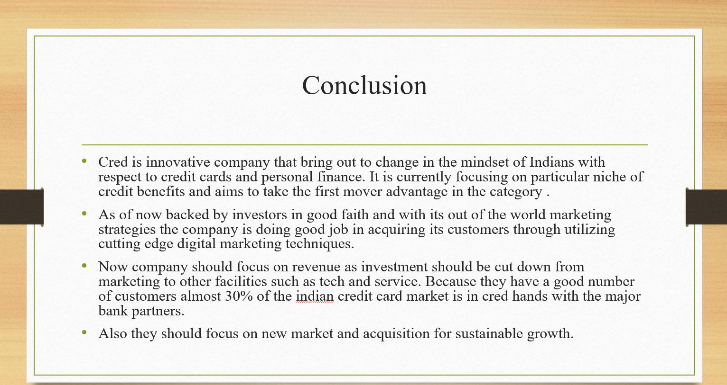
Conclusion
Cred is innovative company that bring out to change in the mindset of Indians with respect to credit cards and personal finance. It is currecntly focusing on particular niche of credit benefits and aims to take the first mover advantage in the category .
As of now backed by investors in good faith and with its out of the world marketing strategies the company is doing good job in acquiring its customers through utilizing cutting edge digital marketing techniques.
Now company should focus on revenue as investment should be cut down from marketing to other facilities such as tech and service. Because they have a good number of customers almost 30% of the indian credit card market is in cred hands with the major bank partners.
Also they should focus on new market and acquisition for sustainable growth.

Slide 14
Link for Tableau Public
https://public.tableau.com/views/Creddashboard/Dashboard1?:language=en-US&publish=yes&:display_count=n&:origin=viz_share_link

